Slide 1
ENSE 374, Milestone 2
Group07
Jacob Chapman, William Peers, JingKang Yang
October 23rd, 2019

Slide 2
Our vision / rationale
Our vision is to design and develop a website application that will allow users to have a fun time, while also learning about their engineering professors too.
The project is a video game to match cards respective to each other.
These cards will have engineering professors faces on them to which the user will have to find the corresponding card with the matching face.

Slide 3
MVC Architecture

Slide 4
MVC Architecture
MODEL
- Professor Data
- User information
- Timer
- User scores
- Team member data
VIEW
CONTROLLER
- Cards to manipulate
- Menu for different navigation links
- Different modes
- Sign in / Sign up
- Scores
- Card manipulation
- Link to U of R Engg professors
- link to sign in / sign up
- link to see scores
- link to choose mode
….

Slide 5
UML Diagramming

Slide 6
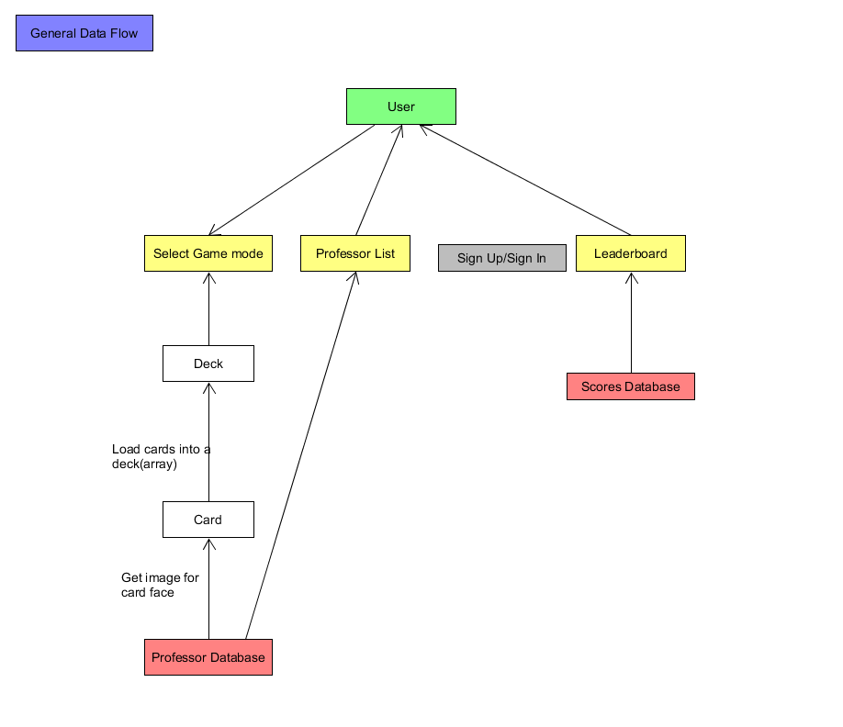
Data Flow Diagram

Slide 7
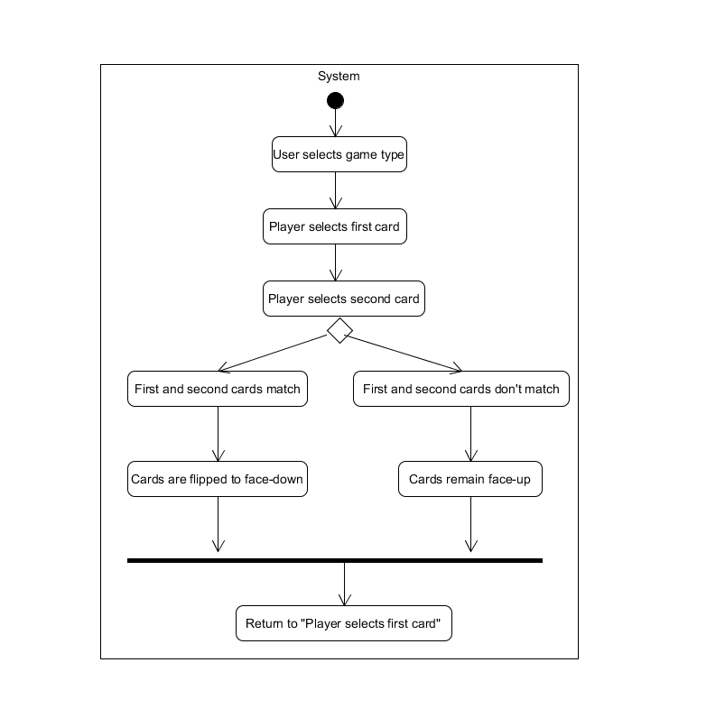
Sequence Diagram

Slide 8
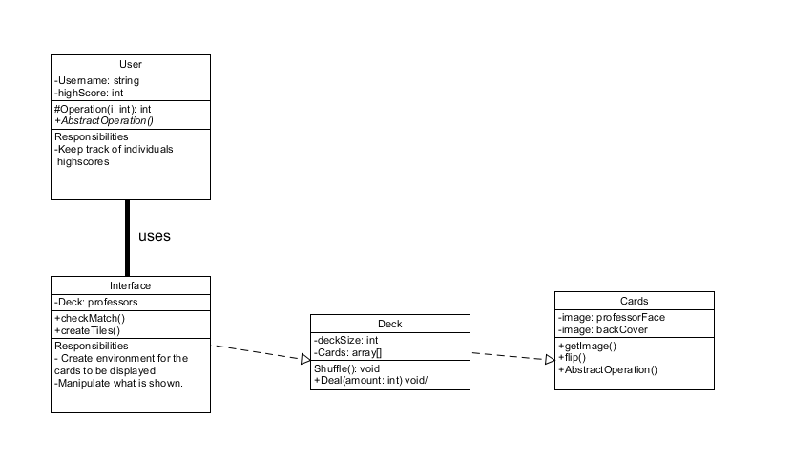
Class Diagram

Slide 9
Lo-Fidelity Prototype

Slide 10
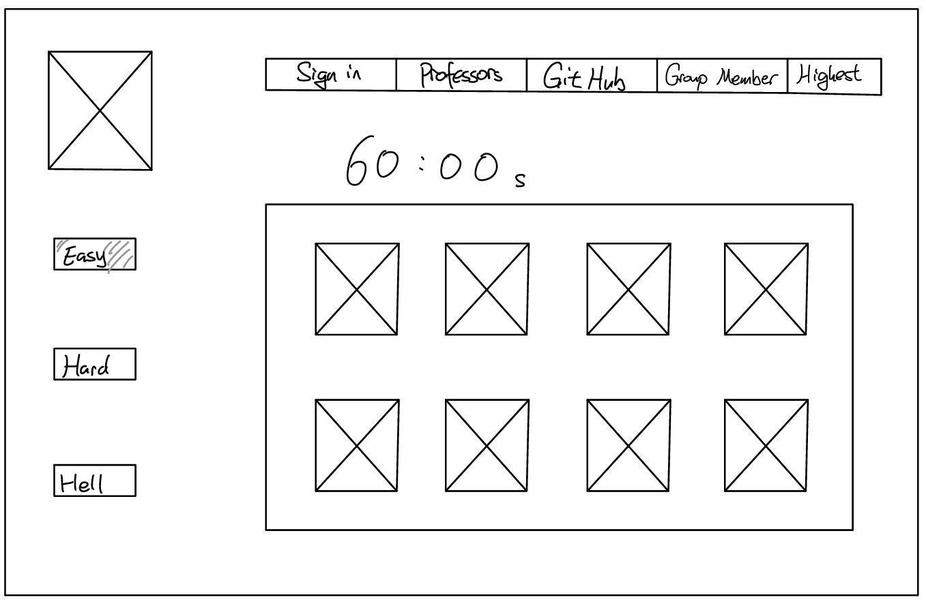
Main Page
U of R Logo (Link to U of R)
Difficulty

Slide 11
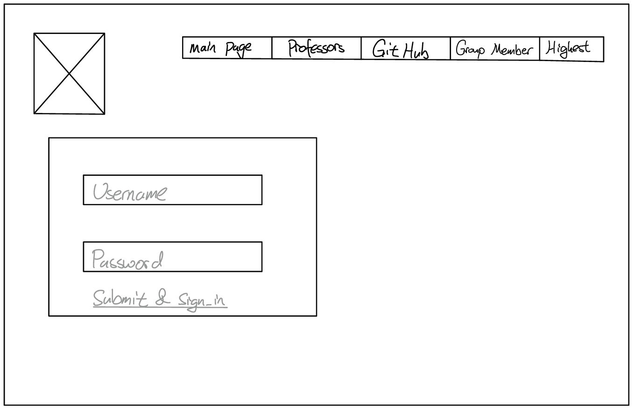
Sign in / Sign Up Page

Slide 12
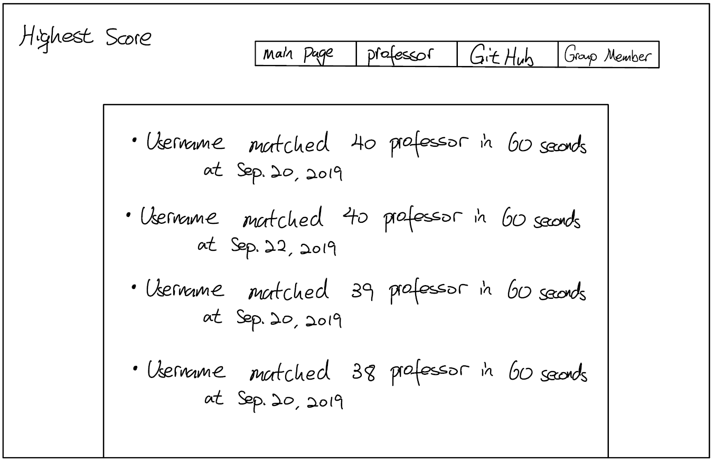
High Score Page

Slide 13
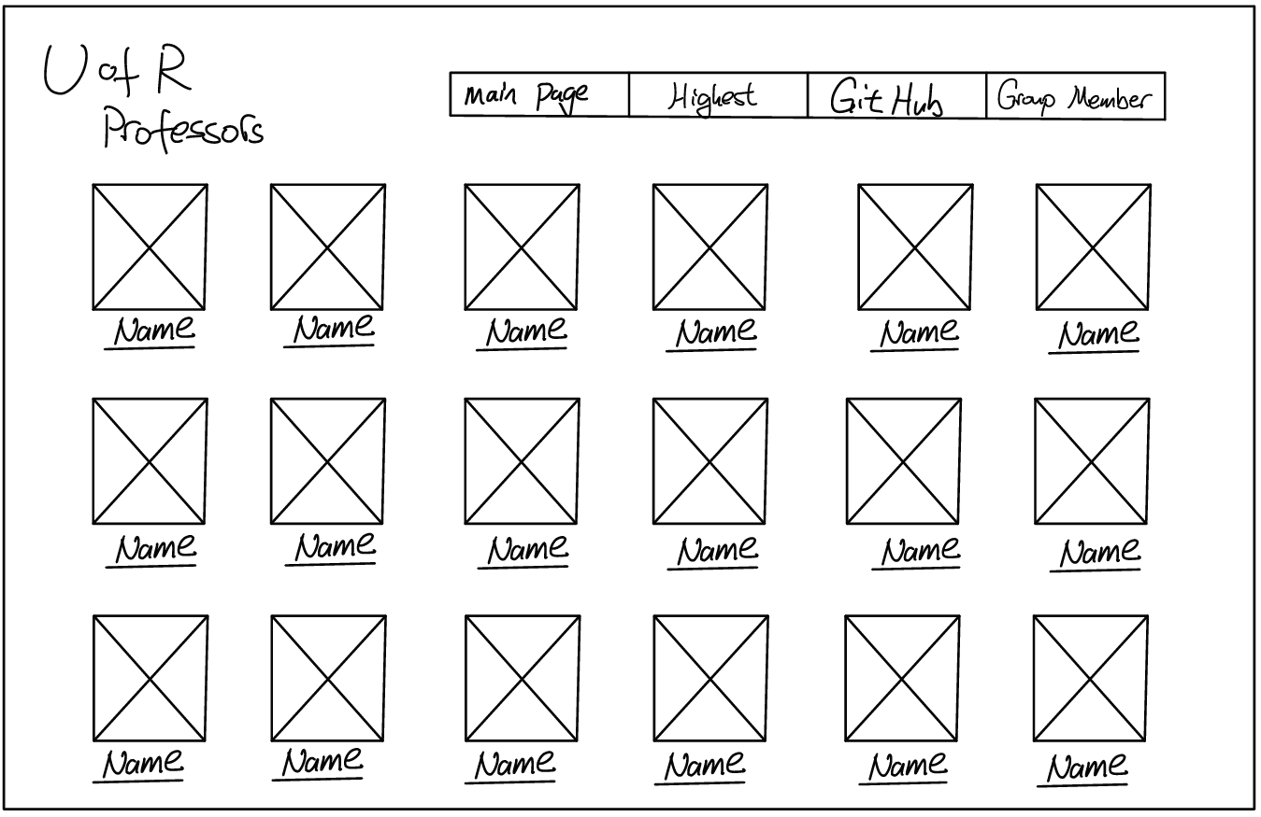
Professor Page
Link to Professor Information Page

Slide 14
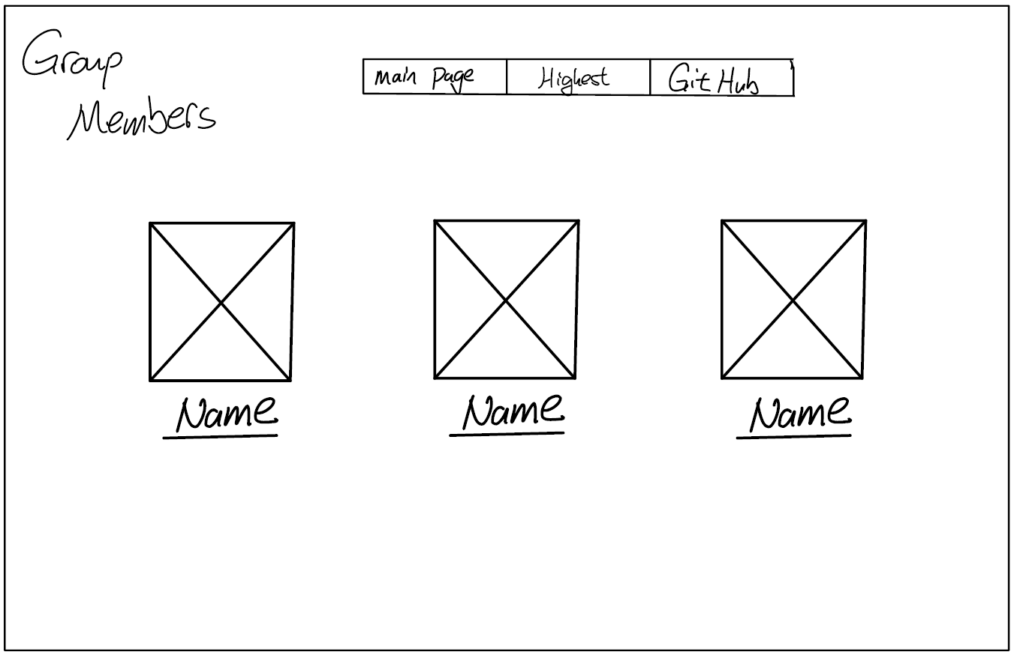
Team Member Page
Link to Personal Webpages

Slide 15
Evolved Requirements
HTML, Java, JavaScript and SQL are the chosen languages for this project
Hercules will be the server location for any data manipulation
Database will hold any professor information, as well as user information and records for high scores

Slide 16
GitHub Link: https://github.com/Jacobchapman99/ENSE-374-Group07-Project

Slide 17
Group Reflection
How did you feel about this milestone? What did you like about it? What did you dislike?
We felt that milestone was good at allowing us to explore different ideas when working with diagrams and it allowed us to visually expect what we are striving to achieve
What did you learn about yourself as you collaborated and worked through this milestone?
We learnt that it is crucial to communicate with each other because MVC, UML, and lo-fidelity prototypes are all connected with each other.
How will you use what you have learned going forward?
Our diagrams, MVC architecture, and Lo-Fi prototypes will be our building blocks for creating a MVP in the next milestone
What “stuff & things” related to this milestone would you want help with?
Making sure we are able to use Hercules as our Server for the project.

